Slide 1
Time Oriented Data Visualization

Slide 2
Visualization Techniques for Time-Oriented Data
Time is an inherent data dimension
  It identifies the patterns and relationships in the data
  It reveals the trends
Time oriented data uses in scientific publications
Time and Time-Oriented data has distinct characteristics → separate data type
If we observes the particular characteristics of time can significantly improve the expressiveness of visual representations.
  chose a visual representation that fits the data characteristics like cycle,..
  Parameterize the visual representation accordingly in a state to identify the hidden patterns in data.

Slide 3
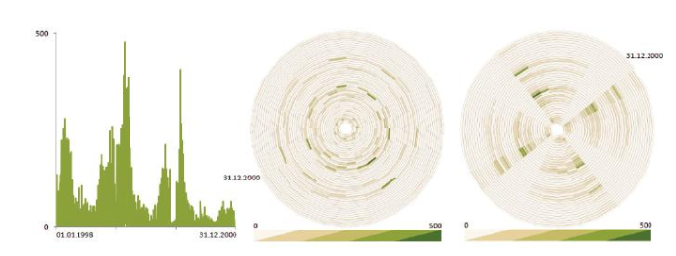
Visualization Techniques for Time-Oriented Data
Visual Representation of time-oriented dataset
  Data set description:
    The daily number of cases of influenza that occurred in the northern part of Germany during a period of three years

Slide 4
Visualization Techniques for Time-Oriented Data
Visual Representation of time-oriented dataset
  The Left-most image uses simple line-plot to visualize the data
  The peaks has some significance with respect to time
  The cyclic behaviour of the data can be guessed.
    But unable to identify the cyclic temporal pattern in the data
  The middle and Right images shows the circular representation using spiral-shaped time axis.
  The cyclic pattern is not visible in the middle images, because the cycle length has been set to 24 days → which does not match the pattern in data.
  The Right image uses cycle length as 28 days. → reveals the periodic pattern in the data. ### able to see the weekly pattern if the cycle length is 7 or 14

Slide 5
Visualization Techniques for Time-Oriented Data
Modelling the time in information system
  Imitate the physical dimension time
  To provide a model that is best suited to reflect the phenomena
  Support the analysis task
There are many ways to model the time in information systems
The time in information system can be modelled differently for different application based on the particular problem.
Notion of time in many areas like AI, data mining, simulation, modelling, databases etc.

Slide 6
Visualization Techniques for Time-Oriented Data
Characteristics of Time: general aspects Vs hierarchical Vs Concrete
  The general aspects of time are scale, scope, arrangement and viewpoints
  Scale:
    Ordinal time domain: Relative order relation
      Example: before, after, during
    Discrete time domain: Temporal distance can also be considered
      Time values can be mapped to a set of integers.
      Discrete time domains are based on a smallest possible unit (second, minutes)
    Continuous time domain: mapping to real numbers, between any two points in time
      Simply called as Dense time

Slide 7
Visualization Techniques for Time-Oriented Data
Characteristics of Time:
  The general aspects of time are scale, scope, arrangement and viewpoints
  Scope: scope of the basic element that constitute of the time domain
    Point-based time domain:
      It is similar to discrete Euclidean points in space, i.e having temporal extent to zero
      Thus, no information is given about the region between two points in time
      Example:
        The time value May 1, 2014 might relate to the single instant May 1, 2014 00:00:00
    Interval-based time domain:
      It is having a temporal extent greater than zero
      This aspect is also closely related to the notion of granularity
      Example:
        time value May 1, 2014 might relate to the interval [May 1, 2014 00:00:00, May 1, 2014 23:59:99]s

Slide 8
Visualization Techniques for Time-Oriented Data
Characteristics of Time:
  The general aspects of time are scale, scope, arrangement and viewpoints
  Arrangement: The arrangement of time domain
    Linear Organization:
      we mostly consider time as proceeding linearly from the past to the future i.e, each time value has a unique predecessor and successor.
    Cyclic Organization:
      The time domain is composed of a set of recurring time values i.e, the seasons of the year
      Hence, any time value A is preceded and succeeded at the same time by any other time value B.
      Example:
        winter comes before summer, but winter also succeeds summer

Slide 9
Visualization Techniques for Time-Oriented Data
Characteristics of Time:
  The general aspects of time are scale, scope, arrangement and viewpoints
  Viewpoint: Views of time, that are modelled
    Ordered time domain:
      The things that are happen one after the other
      In totally ordered domain, only one thing can happen at a time.
      In Partially ordered domain, simultaneous or overlapping events are allowed at a time
    Branching time domain:
      Complex form of time-domain
      Here, multiple strands of time branch out and allow the description and comparison of alternative scenarios ### only one path through time will actually happen
      Example:
        Project Planning, i.e Grantt chart
    Multiple perceptive time domain:
      In multiple perspectives facilitate simultaneous (even contrary) views of time
      Example
        eyewitness reports that describe the same situation, each of which being slightly different

Slide 10
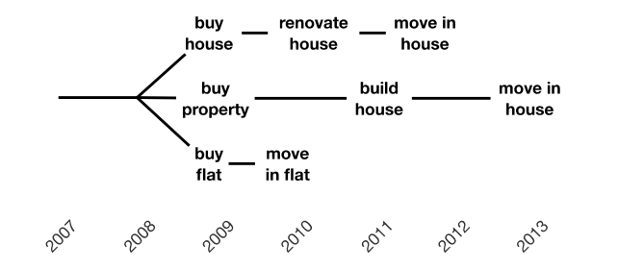
Visualization Techniques for Time-Oriented Data
Characteristics of Time:
  The general aspects of time are scale, scope, arrangement and viewpoints
  Viewpoint: Views of time, that are modelled

Slide 11
Visualization Techniques for Time-Oriented Data
Characteristics of Time:
  The hierarchical organization of time and concrete time elements is determined based on granularity, time primitives, and determinacy.
  Granularity and Calendar: none Vs single Vs multiple
    Basically, granularity can be thought of as a (human-made) abstraction of time in order to make it easier to deal with time in everyday life (such as minutes, hours, days, weeks, months)
    To tackle the complexity of time and to provide different levels of granularity useful abstractions can be employed
    More generally, granularity describes mappings from time values to larger or smaller conceptual units.
    Multiple Granularity: iff granularity and calendar system is supported by the time model
    Single granularity: Every time value is given in terms of milliseconds
    None granularity: None of the abstractions are supported

Slide 12
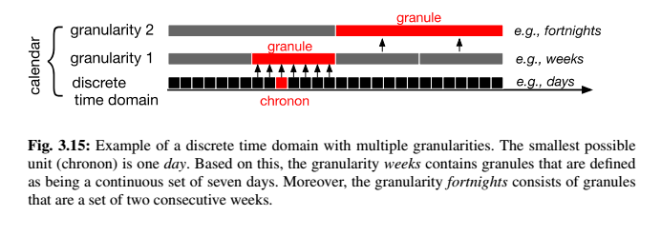
Visualization Techniques for Time-Oriented Data
Characteristics of Time:
  The hierarchical organization of time and concrete time elements is determined based on granularity, time primitives, and determinacy.
  Granularity and Calendar: none Vs single Vs multiple

Slide 13
Visualization Techniques for Time-Oriented Data
Characteristics of Time:
  The hierarchical organization of time and concrete time elements is determined based on granularity, time primitives, and determinacy.
  Time primitives: Instant Vs Internal Vs Span
    These time primitives can be seen as an intermediary layer between data elements and the time domain.
    Time primitives can be divided into anchored (absolute) and unanchored (relative) primitives
    Instant and interval are primitives that belong to absolute primitives
      These are located on a fixed position along the time domain
      Instants are a model for single points in time.
      intervals range between two points in time.
    a span is a relative primitive
      it has no absolute position in time
      spans are durations without a fixed position

Slide 14
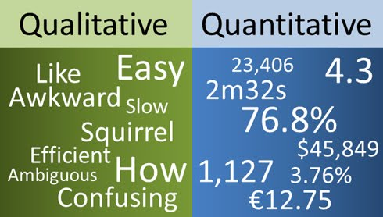
Visualization Techniques for Time-Oriented Data
Characteristics of Time-Oriented Data:
  These primary categories form a basis for finding an expressive, appropriate, and effective visualization technique for time-oriented data
  Scale: quantitative Vs qualitative
    Quantitative data are based on a metric scale (Discrete or Continuous)
    Qualitative data describe either unordered (nominal) or ordered (ordinal) sets of data elements

Slide 15
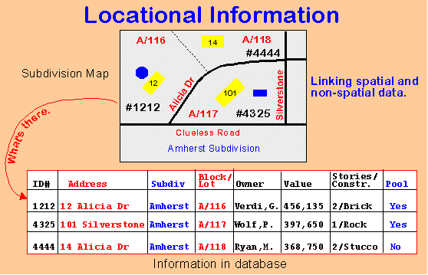
Visualization Techniques for Time-Oriented Data
Characteristics of Time-Oriented Data:
  Frame of Reference: abstract Vs spatial
    Abstract data (e.g., a bank account) have been collected in a non-spatial context
    Spatial data (e.g., census data) contain an inherent spatial layout, e.g., geographical positions.

Slide 16
Visualization Techniques for Time-Oriented Data
Characteristics of Time-Oriented Data:
  Kind of Data: events Vs states
    Events can be seen as markers of state changes example: result out
    States can be characterize the phases of continuity between the events

Slide 17
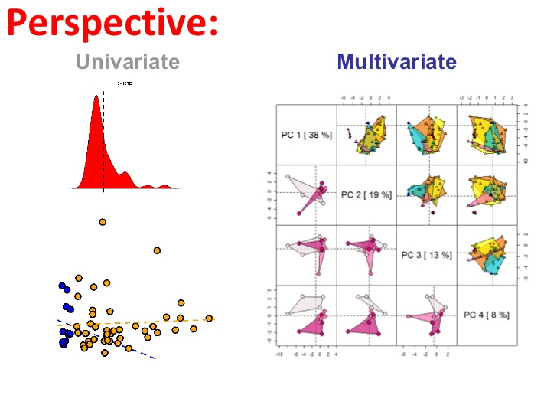
Visualization Techniques for Time-Oriented Data
Characteristics of Time-Oriented Data:
  Number of Variables: univariate Vs multivariate
    Univariate data contain only one data value per temporal primitive
    multivariate data each temporal primitive holds multiple data values

Slide 18
Visualization Techniques for Time-Oriented Data
Relating Data and Time:
  Time dependency of data have been extensively examined in the field of temporal databases
  Two temporal domain of datasets are: 1. Internal Time 2. External Time
  Internal time:
    It is a temporal dimension inherent in the data model.
    Internal time describes when the information contained in the data is valid.
  External time:
    It is an extrinsic to the data model.
    The external time is necessary to describe how a data set evolves in (external) time.

Slide 19
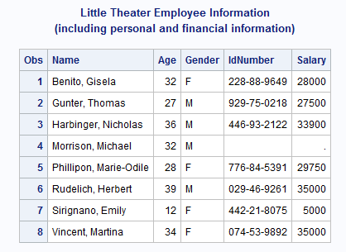
Visualization Techniques for Time-Oriented Data
Relating Data and Time:
  Time – related data sets can be classified based on internal and external time primitives
    Static Non-temporal Data:
      If both internal and external time are each comprised of only one temporal element, the data are completely independent of time.

Slide 20
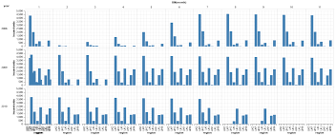
Visualization Techniques for Time-Oriented Data
Relating Data and Time:
  Time – related data sets can be classified based on internal and external time primitives
    Static temporal Data:
      If the internal time contains more than one time primitive, while the external time contains only one, then the data can be considered dependent on time.
      Common time-series are a prominent example of static temporal data.

Slide 21
Visualization Techniques for Time-Oriented Data
Relating Data and Time:
  Time – related data sets can be classified based on internal and external time primitives
    Dynamic Non - temporal Data:
      If the internal time contains only one, but the external time is composed of multiple time primitives, then the data depend on the external time.
      The data change over time, i.e., they are dynamic.
      The historical view of the data is not maintained.

Slide 22
Visualization Techniques for Time-Oriented Data
Relating Data and Time:
  Time – related data sets can be classified based on internal and external time primitives
    Dynamic temporal Data:
      If both internal and external time are comprised of multiple time primitives, then the data are considered to be bi-temporally dependent
      the data contain variables depending on (internal) time, and the actual state of the data changes over (external) time.

Slide 23
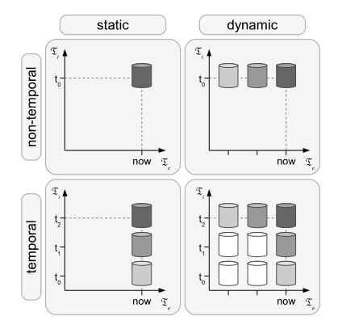
Visualization Techniques for Time-Oriented Data
Relating Data and Time:
  Time – related data sets can be classified based on internal and external time primitives

Slide 24
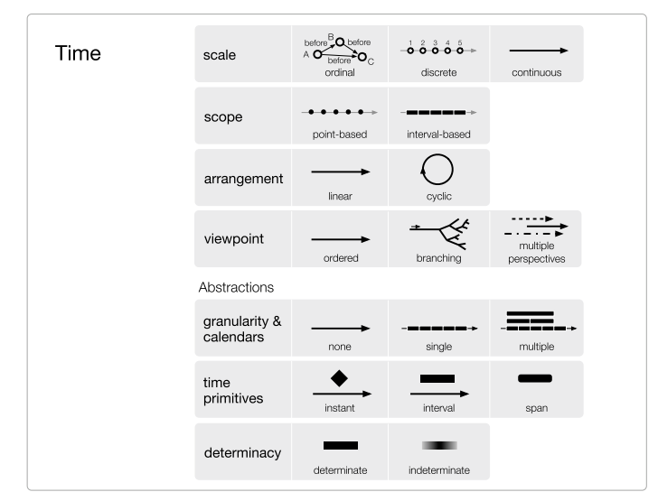
Visualization Techniques for Time-Oriented Data
Relating Data and Time:

Slide 25
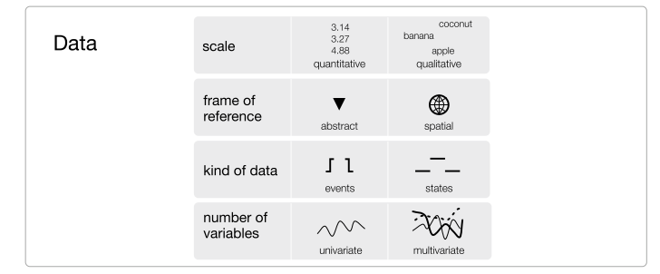
Visualization Techniques for Time-Oriented Data
Relating Data and Time:

Slide 26
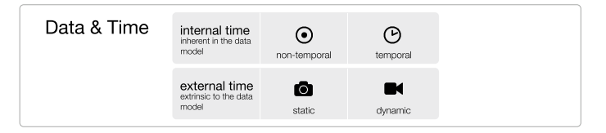
Visualization Techniques for Time-Oriented Data
Relating Data and Time:

Slide 27
Visualization Techniques for Time-Oriented Data
Visualizing Time-Oriented Data :

